Slide 1
Local Safeguarding Children Arrangements (England)
Peer Support for Chief Officers and delegates
August 2023

Slide 2
The VKPP
The programme formed to improve policing’s collective response to the protection of individuals experiencing vulnerability from abuse, neglect, and exploitation.
Working with NPCC through the Violence and Public Protection (VPP) lead the VKPP undertake a wide range of activities to reduce threat and harm, bring more offenders to justice, and improve outcomes for victims.
Following the enactment of Children and Social Work Act (2017) & Working Together (2018), Chief Constables and their delegates’ responsibilities were expanded in relation to Multi-Agency Local Arrangements for children.
Local Safeguarding Children Boards (LSCBs) and Independent Chairs were replaced. To support this transition, the Policing Facilitator (PF) role was created, a tactical advisor for Chief Officers and other executive leads.

Slide 3
The facilitator provides
One to one peer support
Tactical advice
Products and resources
Continuing Professional Development
Advice to government, amplifying the voice of policing order to influence policy design
Coordination between NPCC portfolios
Communication with partner organisations at national level

Slide 4
The facilitator connects with;
College of Policing
HMICFRS
NPCC portfolio leads and staff officers, CPAI and MASH in particular
APCC
Government; Departments for Education, Health and Social Care, Home Office
Partners;
Association of Directors of Childrens Services, Ofsted, NHS England & National Network of Designated Healthcare Professionals
The wider VKPP programme of work.
Whilst The role is not part of the VKPP peer review function it can be designed into local peer review offers where relevant

Slide 5
The value of facilitation
Value: Many senior leaders say that the PF role is invaluable to their job.
National picture: Senior leaders find the information and advice about the national perspective very helpful.
Networking: Senior leaders report that events held, and advice given provides a useful network for them.
Best practice: Senior leaders felt that it would be helpful if the facilitator could provide examples of best practice.
Resource for leaders: The vast majority of senior leaders deem a future resource for leaders created by the facilitator as either helpful or very helpful.
Notes:
Evaluation of the role was concluded July 2023 and is available from the VKPP for review
“Policing gets immense value from the VKPP on the police facilitator role. I couldn't do my job as the national policing lead without the Police facilitator or without the VKPP”
“I think it's just invaluable you know, actually having that point of contact, if we're not sure of anything being able to contact someone and say: this has come out, what do we do about it? Do you know who to contact? Can you give us some? Can you simplify it for us? So from me, I just think it's a really valuable resource that's free as well”
“Because I can really see the value of the facilitator and their role. I think they bring really unique perspective to that role. And they’re brilliant. I think they do a really great job, and they really supports police forces and but more importantly, they really get it. They understands what it's like and they understand it from political context as well as a force led context”
“It's been very useful in hearing the national position and national developments on how things should be happening so that you can then reference and translate those into local practice. Because what tends to happen in policing is that local practices build up over a period of time, often good natured and meant with good intent, which don't necessarily reflect what Working Together might say or what the latest recommendations from a child safeguarding review say“
[the PF] is able to come and talk about the national direction and she articulates that very well as does her colleagues”
“I think we should be bolstering that support rather than thinking about how in terms of austerity, the benefit that the facilitator brings. Whilst it might not be measurable and the rest of the team, it's absolutely invaluable and knowing they are on the end of the phone or at the end of an e-mail if I'm kind of struggling with something or trying to think of a way through and I know that I can pick up the phone to them and they can be that critical friend, that is absolutely invaluable”

Slide 6
Accessing facilitation
Email Lorraine.parker@norfolk.police.uk
This free service to policing is;
intended for Chief Officers and other senior leaders in the Police system
flexible to the needs of local leaders, as informal or formal as suits
intended to build knowledge, understanding and confidence
provided/delivered by Chatham House rules or where necessary in confidence unless all parties agree to share information
supportive
a continuing offer
in place until March 2025

Slide 7
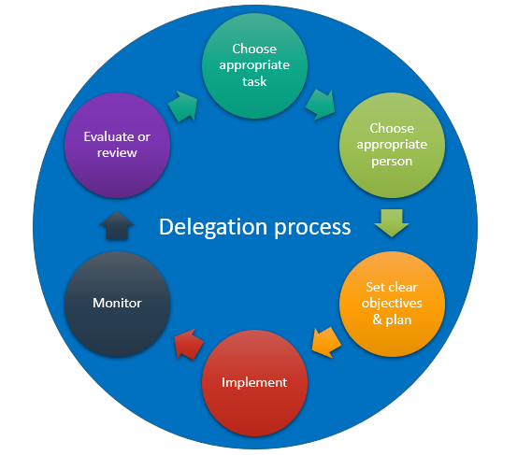
Peer support and development sessions focus on;
Leadership, accountability
and delegation
Underpinned by sponsorship and active involvement of Chief Officer leads
Notes:
Some force references;
MPS
GMP
D&C
West Yorkshire
Merseyside
Dorset
West Midlands

Slide 8
Reference;
Children's social care stable homes built on love consultation (publishing.service.gov.uk)
Working Together to Safeguard Children: changes to statutory guidance - Department for Education - Citizen Space
Children’s social care national practice group - GOV.UK (www.gov.uk)

Slide 9
Reference;
Child Safeguarding Practice Review Panel - GOV.UK (www.gov.uk)
Protocol for Liaison and Information Exchange when criminal proceedings coincide with Child Safeguarding Practice Reviews in England | The Crown Prosecution Service (cps.gov.uk)
Independent Scrutiny and Local Safeguarding Children Partnership Arrangements – August 2022 | Vulnerability Knowledge and Practice Programme (vkpp.org.uk)

